Slide 1
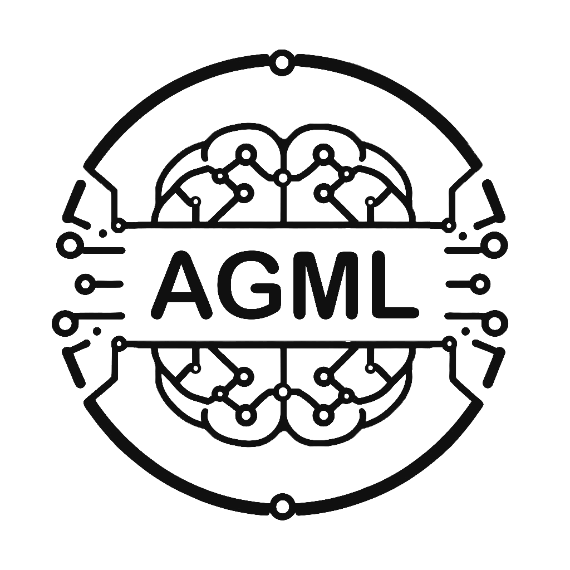

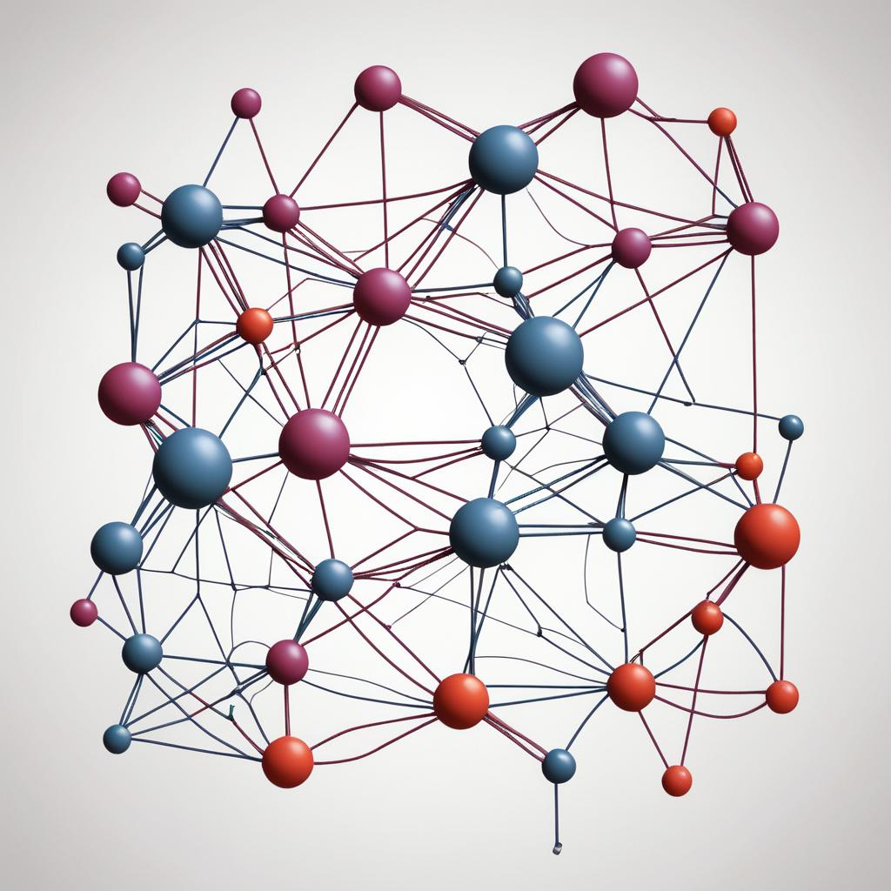
GraphAny A Foundation Model for Node Classification on Any Graph
Ali Vefghi
Prof. Rahmati
Author(s): Jianan Zhao et al.
Mila - Québec AI Institute, University of Montréal, Intel AI Lab
University of Oxford, HEC Montréal, CIFAR AI Chair

Slide 2
Definitions
Foundation models
trained on broad data such that it can be applied across a wide range of use cases (text or images)
a shared input space across all tasks (e.g. a vocabulary of tokens or a patch of pixels)
Inference
Inductive/transductive
Homophilic/ heterophilic graphs
In homophilic graphs, node label largely depends on the labels of its close neighbors whereas in heterophilic graphs, node label does not depend on the neighboring nodes.

Slide 3
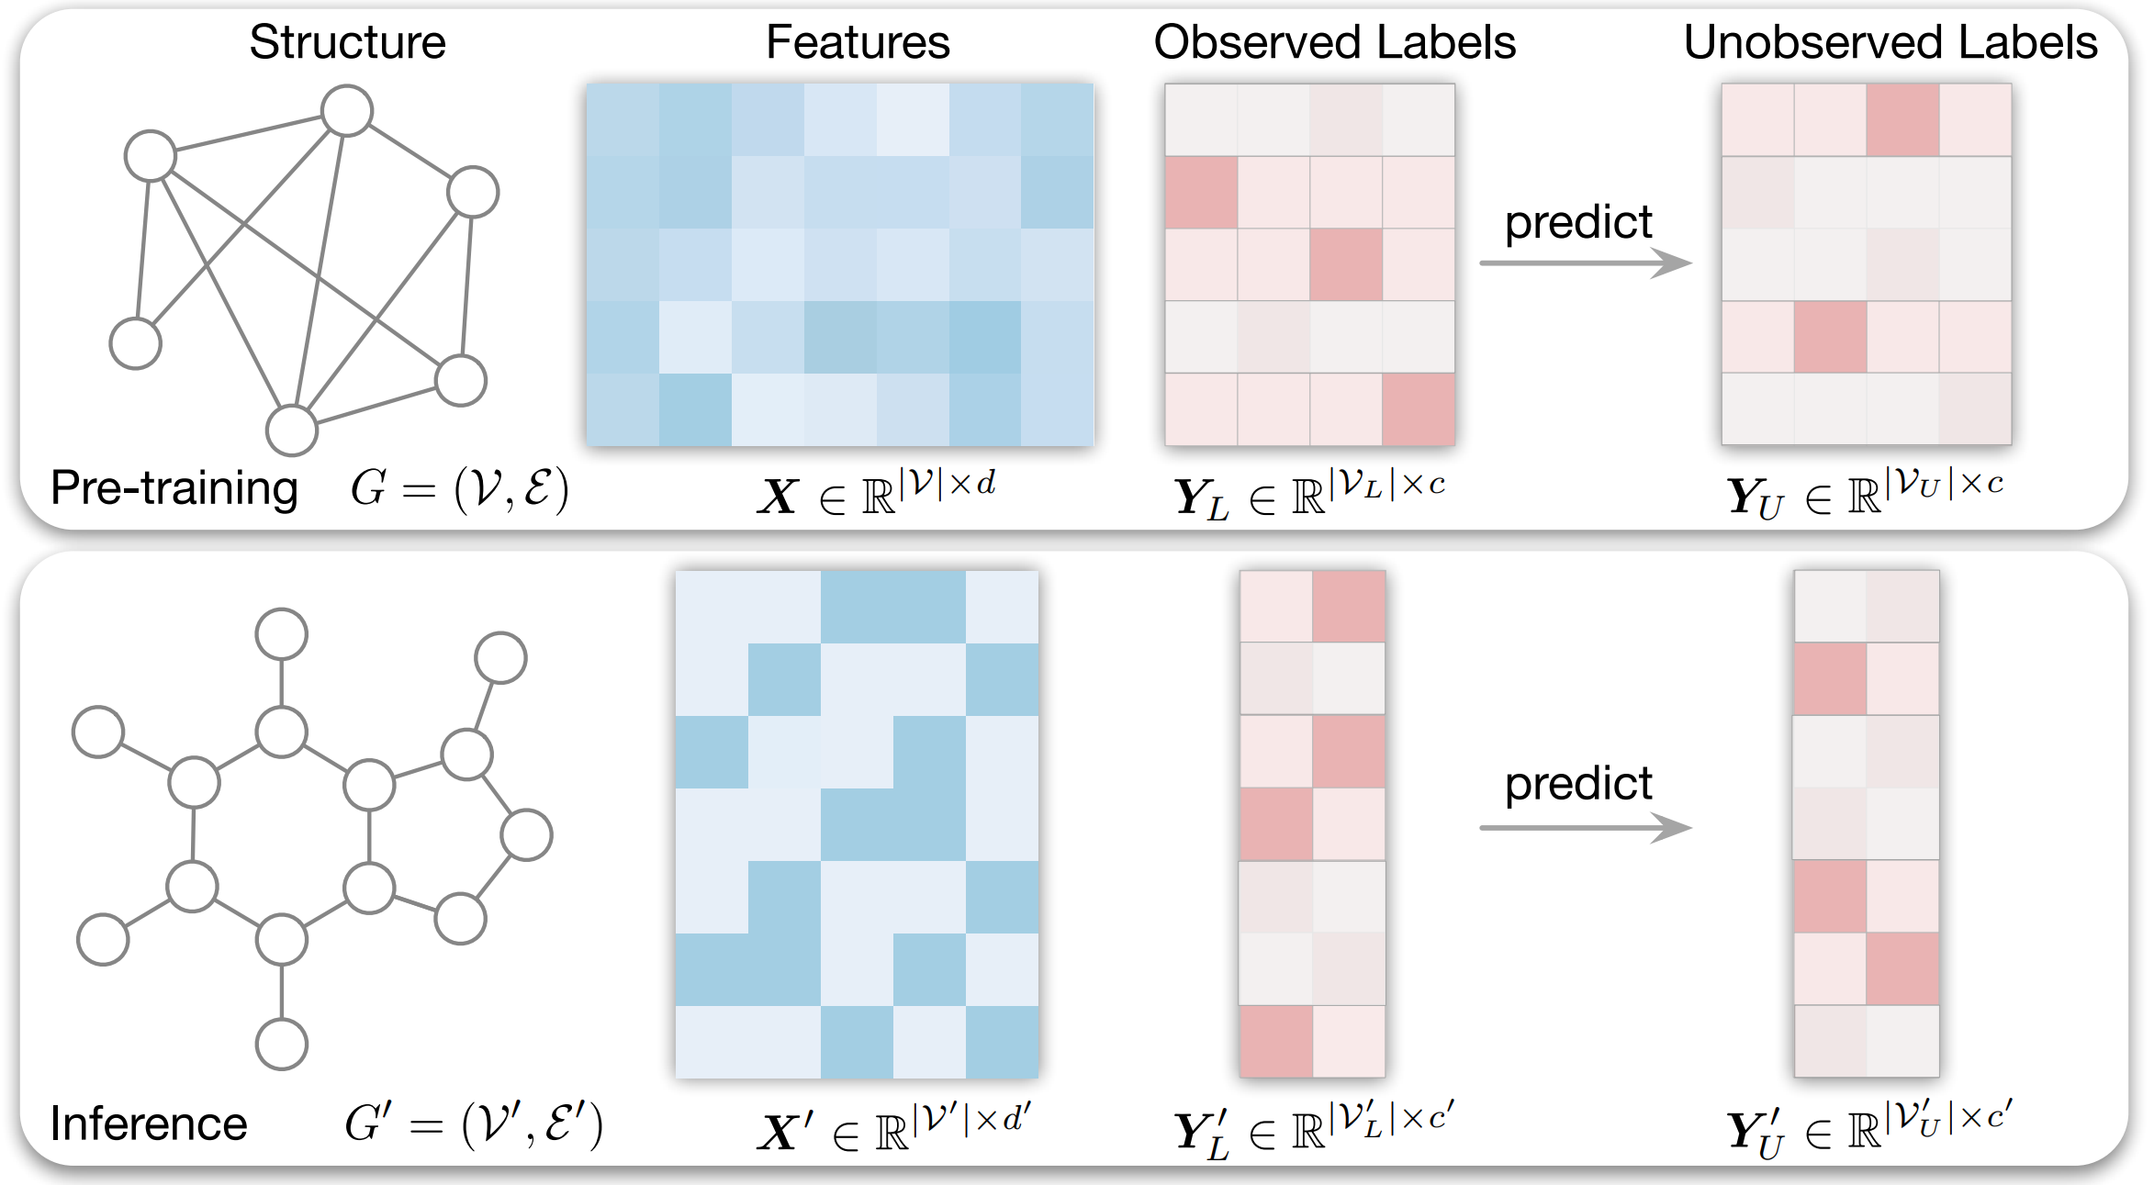
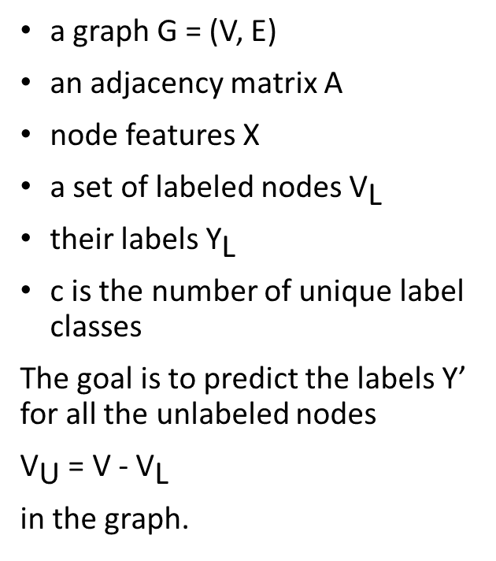
Problem definition
a graph G = (V, E)
an adjacency matrix A
node features X
a set of labeled nodes ${\text{V}}_{\text{L}}$
their labels ${\text{Y}}_{\text{L}}$
c is the number of unique label classes
The goal is to predict the labels Y’ for all the unlabeled nodes
${\text{V}}_{\text{U}}$ = V -${\text{V}}_{\text{L}}$
in the graph.

Slide 4
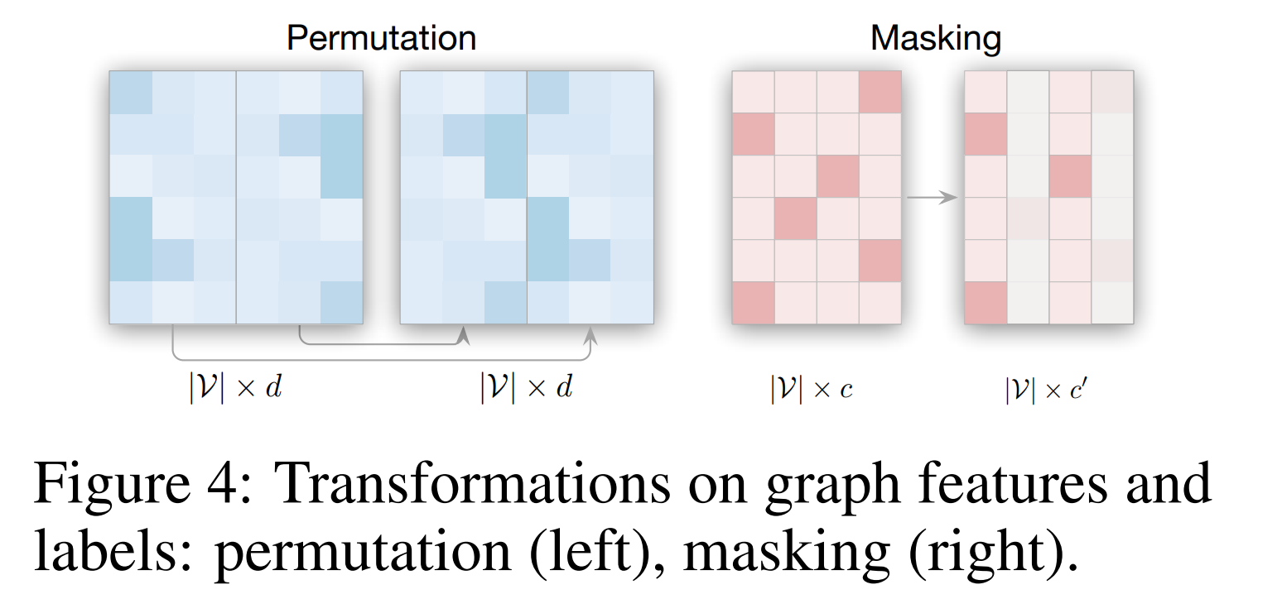
Problem definition
Different feature and label spaces across graphs
Existing models learn transformations specific to the dimension, type, and structure of the features and labels used in the training, and cannot perform inference on feature and label spaces that are different from the training ones, which can also appear in an arbitrary permuted order.
An inductive function
Existing models learn functions specific to the training graph and cannot generalize to new graphs.

Slide 5
Related works
leverage large language models (LLMs) to solve graph tasks
- they can only deal with text-attributed graphs (text node features and labels)
- features may even be continuous.
Inductive Node Classification
- use known node labels as features and train-test setup is limited to different partitions of the same bigger graph
Labels as Features
Graph Foundation Models
- the main challenge of graph foundation models (GFM) is finding an invariant graph vocabulary that transfers across different graphs.
- LLMs are used here but the sequential nature of LLMs is suitable for graphs with permutation invariance?

Slide 6
Method
GraphAny
An architecture that can solve node classification on any new graph (homophilic and heterophilic) with any feature and label spaces in both transductive and inductive setups
Solutions to challenges:
models inference on a new graph as an analytical solution to a LinearGNN
learns attention scores for each node to fuse the predictions of multiple LinearGNNs
no expensive gradient steps for label prediction

Slide 7
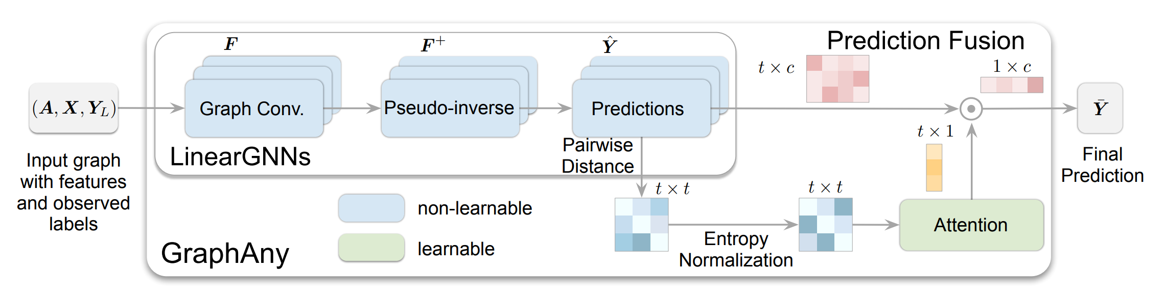
Method
Two main components:
LinearGNNs: An approximation of labels with a transformation in a closed form and non-paramaetric,
An attention module: learns to combine multiple LinearGNNs based on inductive features that generalize to new graphs.

Slide 8
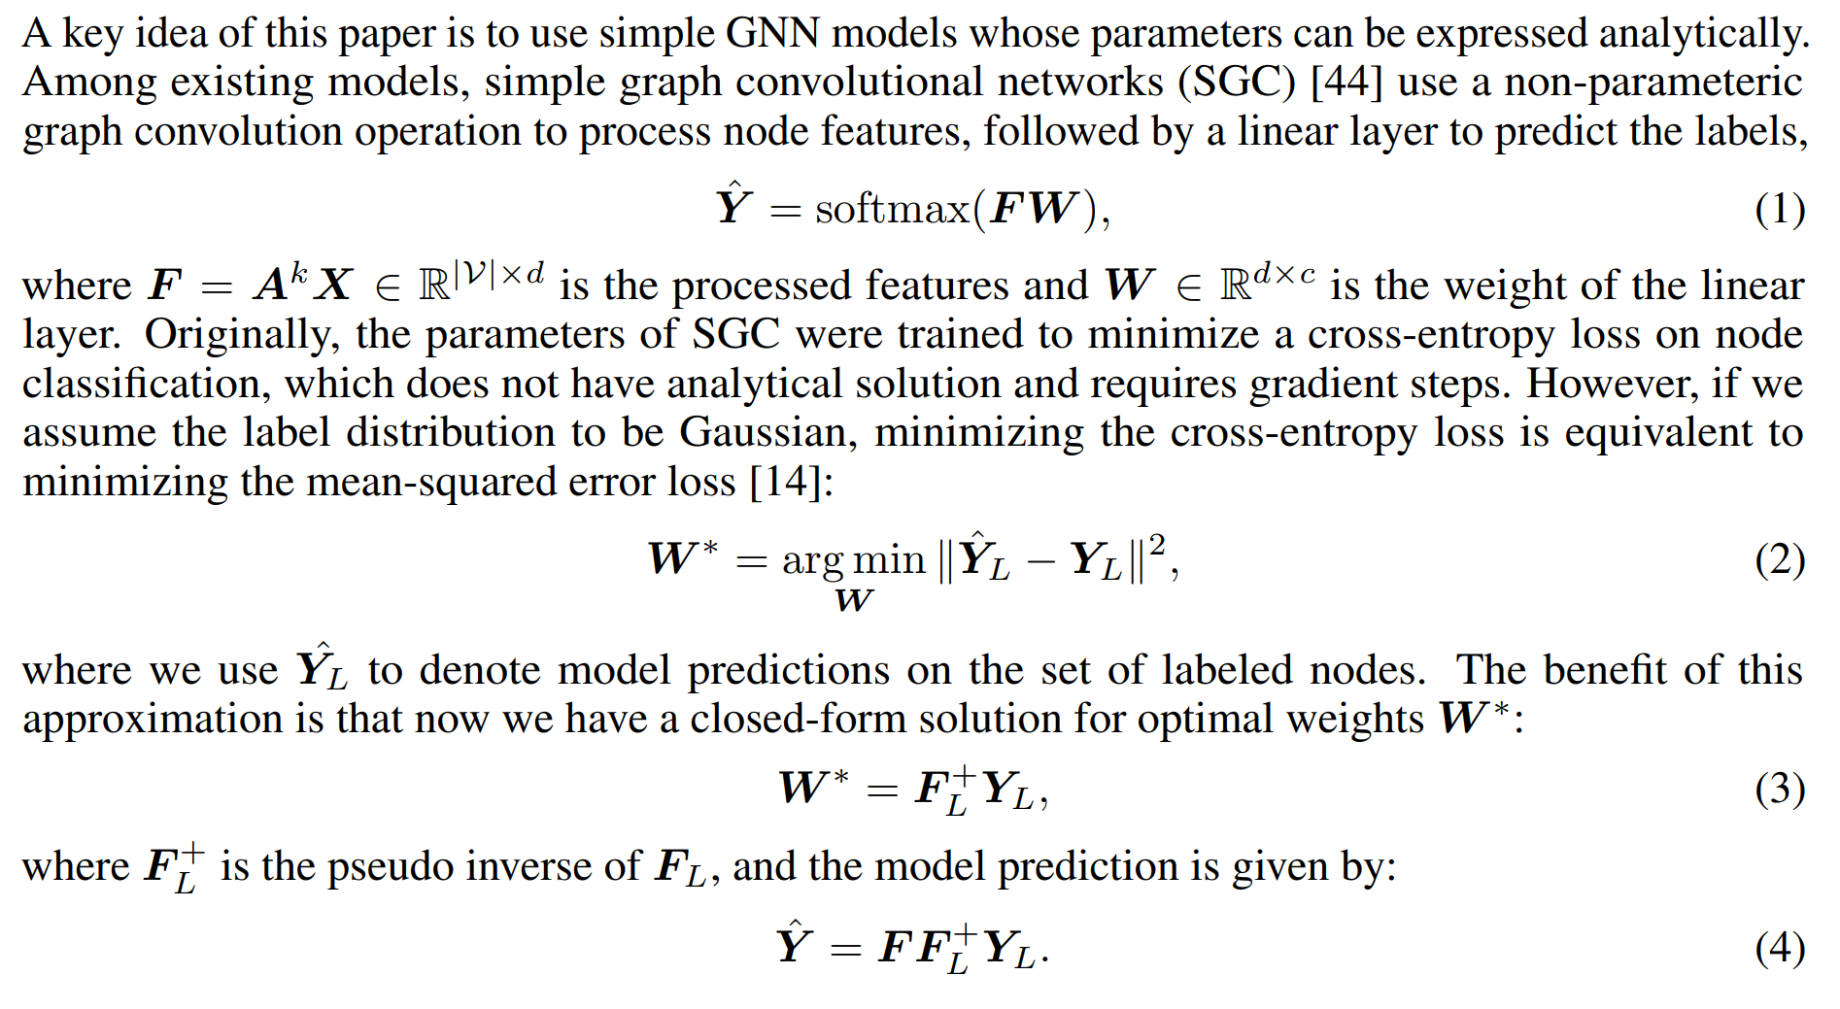
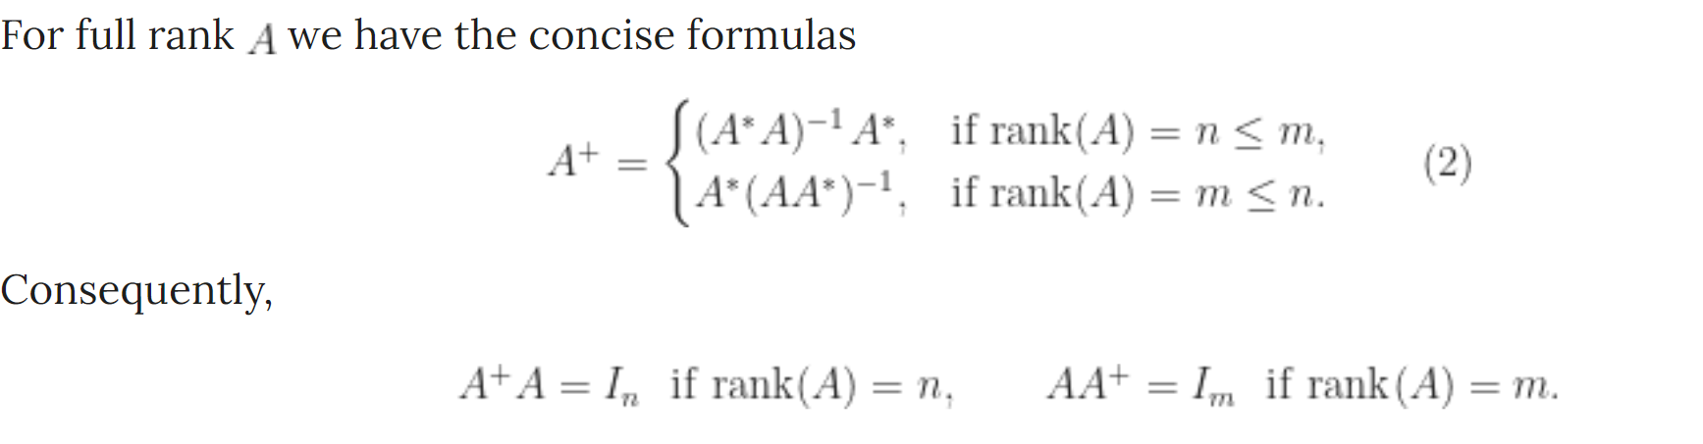
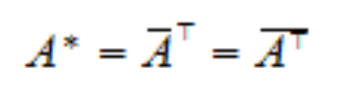
LinearGNNs
Paper: Simplifying Graph Convolutional Networks
Idea is from simple graph convolutional networks (SGC)
It approximates the prediction of linear GNNs (like SGC) with a single forward pass.
- No training
- Same time complexity as a standard GCN at inference time

Slide 9
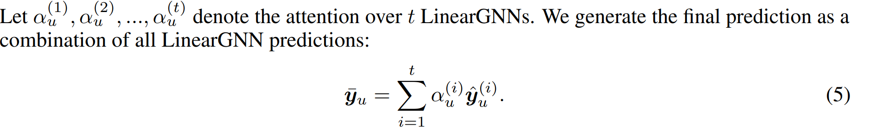
Attention module
An attention module over a set of multiple LinearGNNs
it should be robust to transformations on features and labels, such as permutation or masking on some dimensions

Slide 10
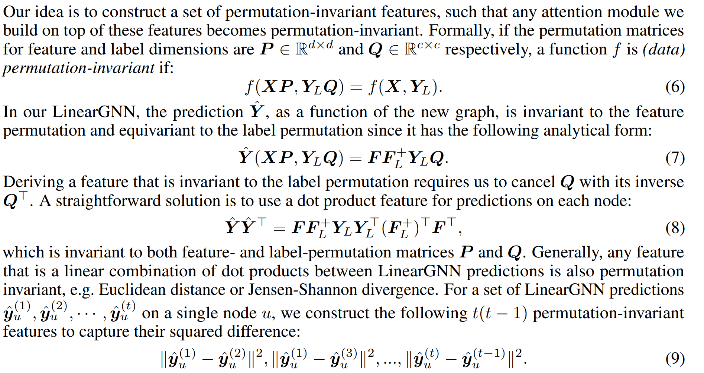
Permutation-Invariant Attention with Distance Features

Slide 11
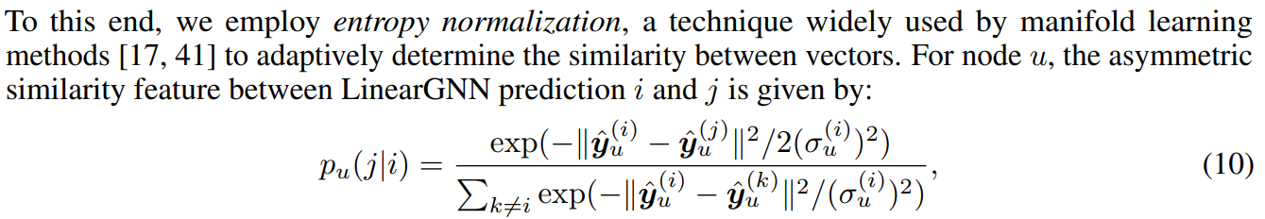
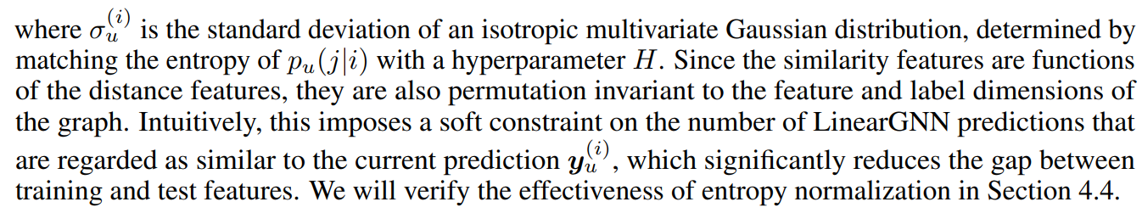
Robust Dimension Generalization with Entropy Normalization

Slide 12
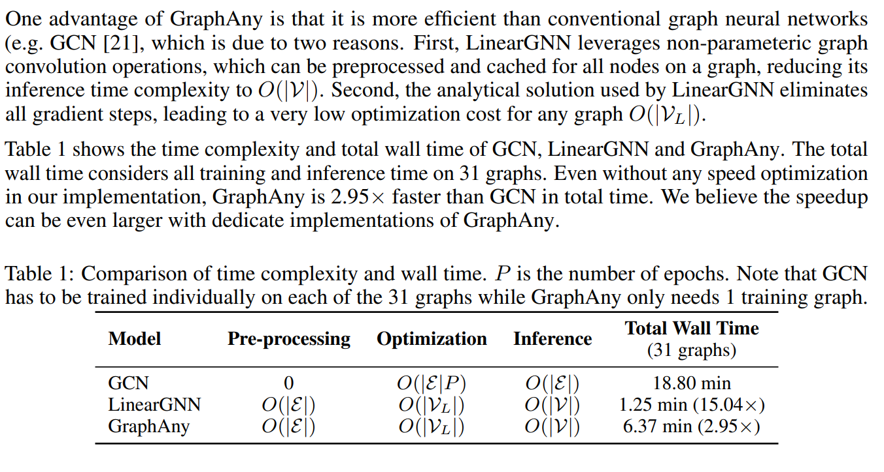
Analysis of Time Complexity

Slide 13
Datasets
Compiled a diverse collection of 31 node classification datasets from three sources: PyG , DGL , and OGB .
These datasets encompass a wide range of graph types including academic collaboration networks, social networks, e-commerce networks and knowledge graphs, with sizes varying from a few hundreds to a few millions of nodes.
The number of classes across these datasets ranges from 2 to 70.
default split if it exists, otherwise, standard semi-supervised setting, where 20 nodes are randomly selected as training nodes for each label.

Slide 14
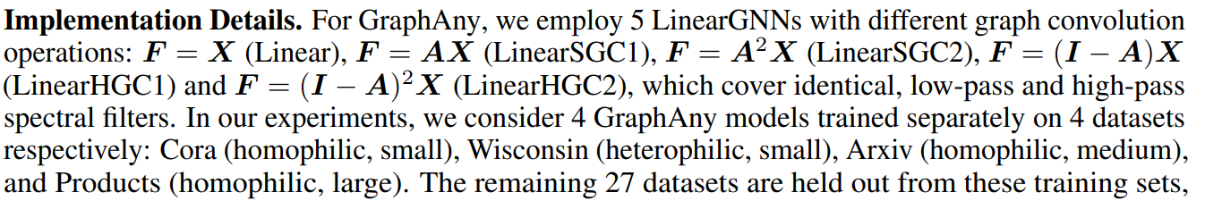
Implementation details

Slide 15
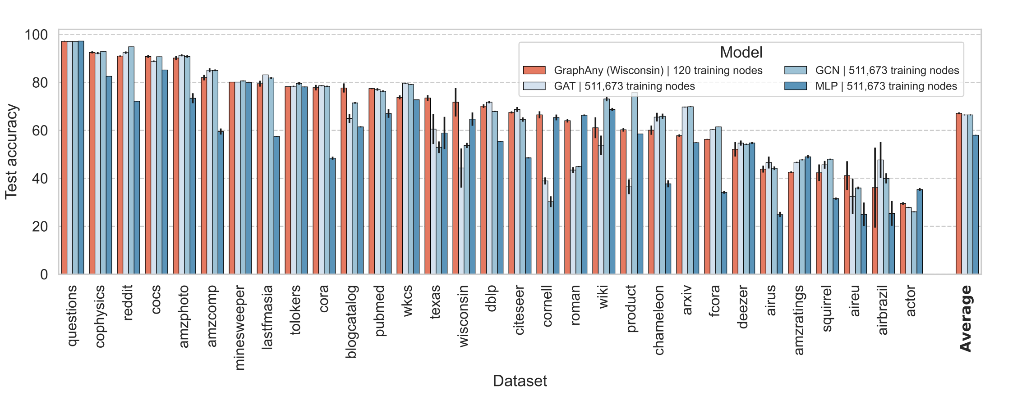
Results

Slide 16
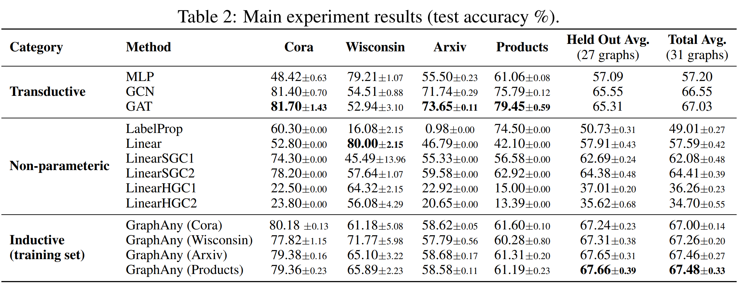
Results

Slide 17
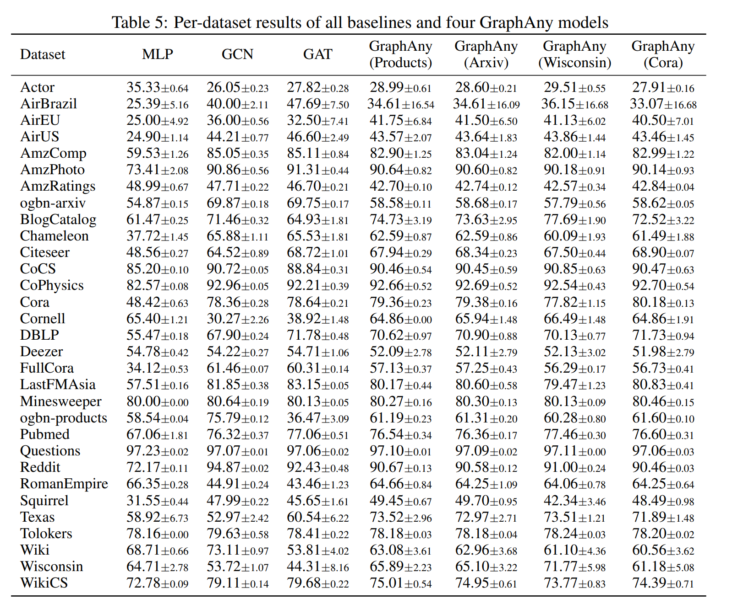
Results

Slide 18
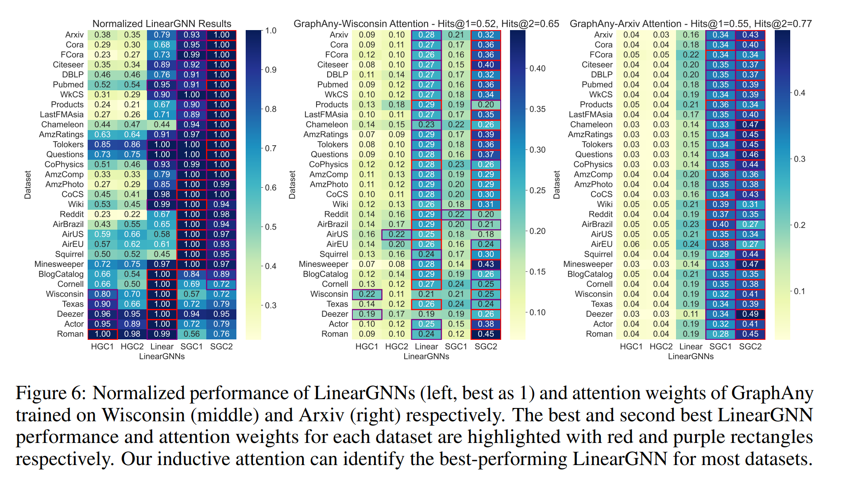
Results

Slide 19
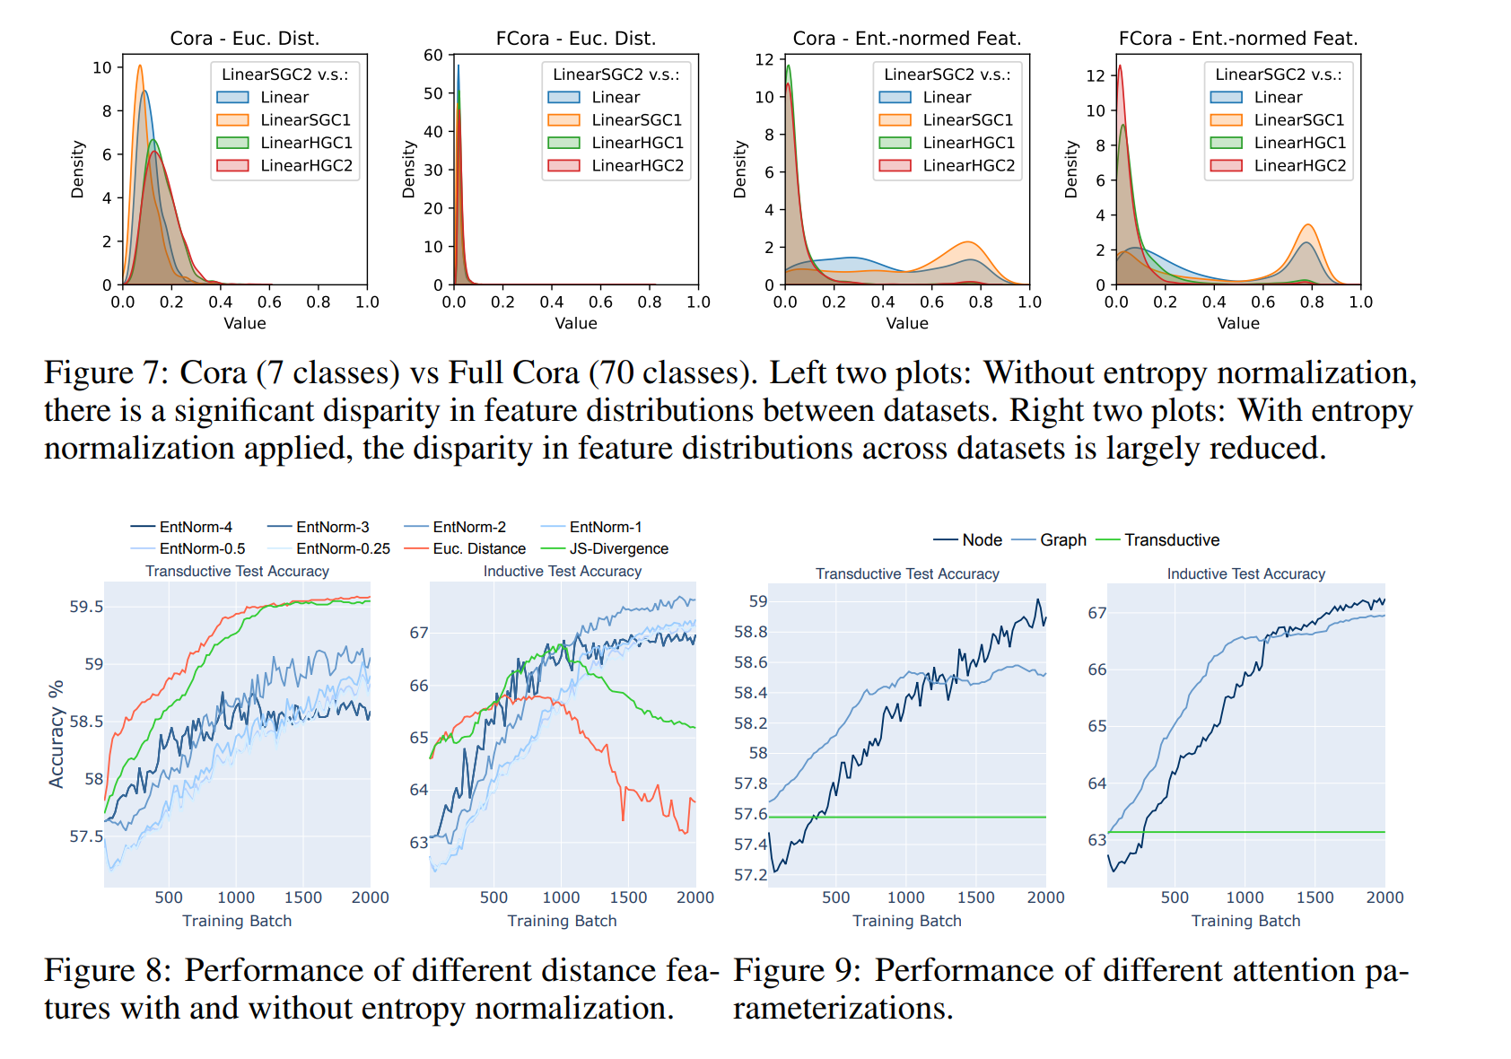
Ablation Study on Entropy Normalization and Attention Parameterization

Slide 20
Limitations and Future Work
First, LinearGNNs have limited expressiveness and cannot fit complex functions on graphs, which may restrict the overall expressiveness of GraphAny even if we combine LinearGNNs with learned attention for each node
Second, GraphAny can only solve node classification tasks at the moment, excluding regression tasks, edge-level or graph-level tasks
Besides, it remains an open question how to apply GraphAny to relational graphs, since non-pararmetric models have never been shown effective for relational graphs
What did I learn from this paper?

Slide 21
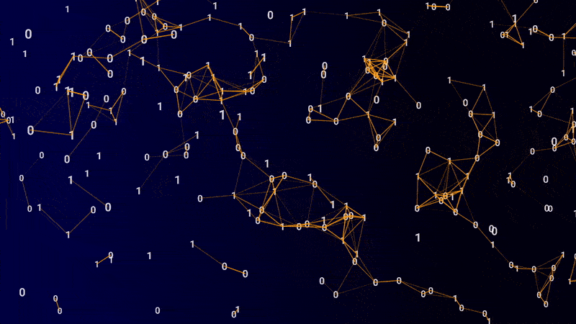
Thank You

